Slide 1
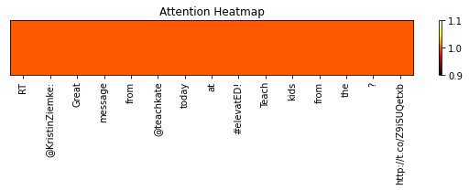
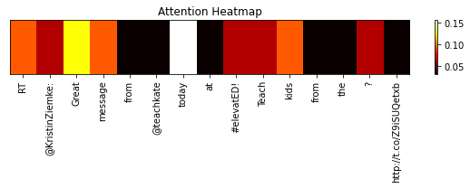
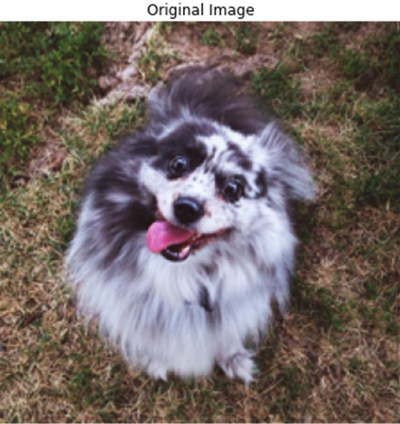
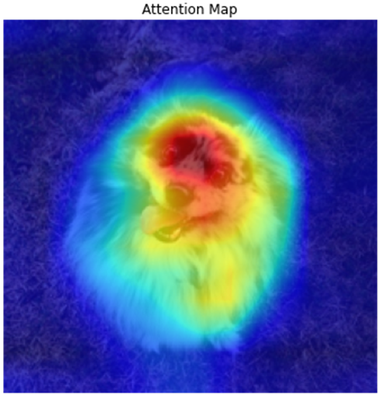
Dual Pipeline Attentional Framework Proposed by cs16-1
Attention
Local Fusion
Pipeline1
Model1
Concatenate
Text Input
Model2
Attention
Pipeline2
activation
emoji Input
Fusion Approach
Global Fusion
Concatenate
Softmax
Prediction
Pipeline1
Attention
activation
Model3
Local Fusion
Image Input
Concatenate
Model4
Attention
Pipeline2

Slide 2
Proposed Model Proposed by cs16-1
Content-based Attention Layer
Local Fusion
Bi-LSTM
Concatenate
Text Input
Bi-LSTM
Content-based Attention Layer
tanh
emoji Input
XGB R.Forest MLP
Global Fusion
Concatenate
Softmax
MaxPooling + BatchNormalisation
Spatial Attention Layer
sigmoid
Multi-CNN
Local Fusion
Image Input
Concatenate
VGG
Spatial Attention Layer

